Slide 1
Identifying Optimal Business Locations
David Simon, IBM Data Science Certificate capstone Project

Slide 2
Business Problem
Location is crucial to retail businesses
One way to find a location for a good retail space is to find one that successful businesses already use
The goal of this project is to identify potentially successful business locations for sandwich shops in the city of San Francisco
First, I’ll find the most attractive sandwich places in San Francisco using the Foursquare API
Next, I’ll identify similar locations in the City of San Francisco using k-means clustering

Slide 3
TOP SANDWICH PLACES IN SAN FRANCISCO
Two steps to identify through Foursquare API:
Iterate through a grid of locations to collect all sandwich shops in San Francisco
(A single search function would only be able to identify 50 sandwich shops)
Find the places with the highest ratings and/or the highest number of tips
These two steps, augmented with a standardized composite score, result in 7 “top” sandwich places in San Francisco

Slide 4
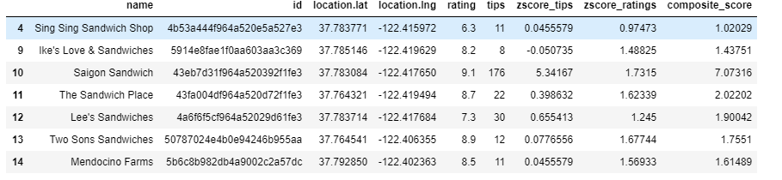
THE LIST OF TOP PLACES

Slide 5
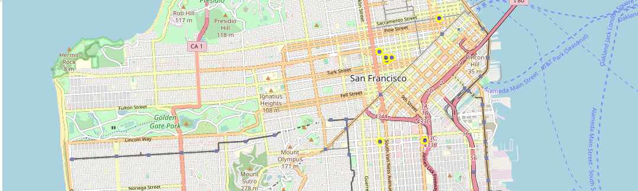
LOCATION OF TOP SANDWICH PLACES

Slide 6
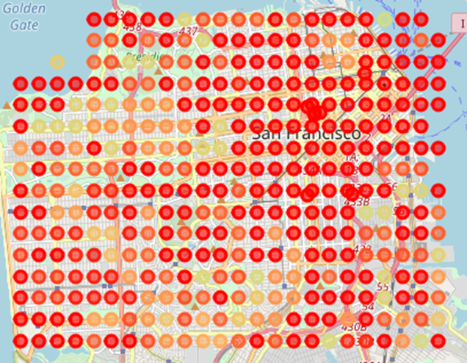
IDENTIFYING SIMILAR DATA POINTS VIA K-MEANS CLUSTERING
25 clusters (the datapoints similar to the top sandwich shops are denoted in red)

Slide 7
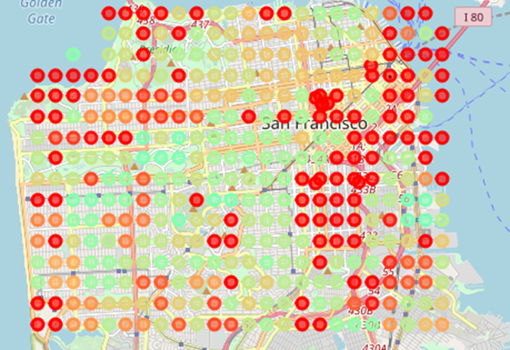
IDENTIFYING SIMILAR DATA POINTS VIA K-MEANS CLUSTERING
50 clusters (the datapoints similar to the top sandwich shops are denoted in red)

Slide 8
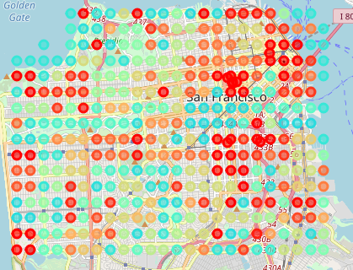
IDENTIFYING SIMILAR DATA POINTS VIA K-MEANS CLUSTERING
100 clusters (the datapoints similar to the top sandwich shops are denoted in red)

